Slide 1
Toward Performance Portable Programming for Heterogeneous Systems on a Chip: A Case Study with Qualcomm Snapdragon SoC
Anthony Cabrera, Seth Hitefield, Jungwon Kim, Seyong Lee, Narasinga Rao Miniskar, and Jeffrey S. Vetter
Oak Ridge National Laboratory
September 20, 2021 @ IEEE HPEC’21

Slide 2
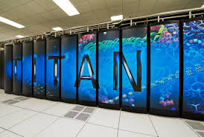
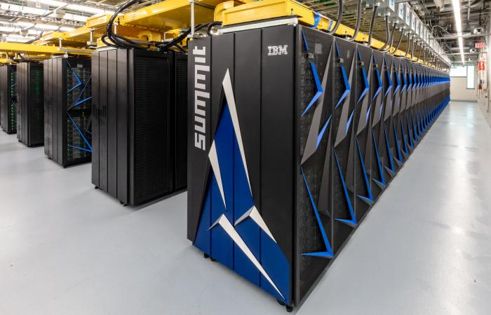
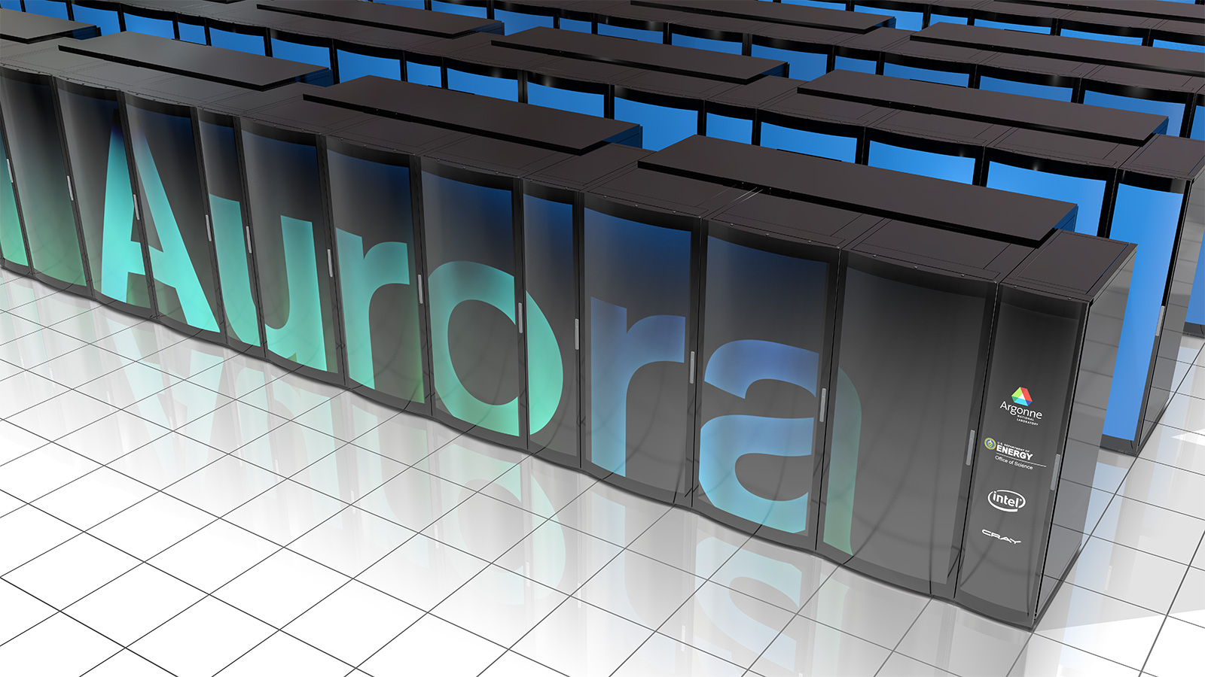

Heterogeneity in High Performance Computing
Titan (2012)
Summit (2018)
Frontier (2021)
Aurora (2022)
CPU
AMD Opteron
Accelerator
Nvidia Tesla
Vendor
Cray
CPU
IBM Power9
Accelerator
Nvidia Volta
Vendor
IBM
CPU
AMD EPYC
Accelerator
AMD Radeon
Vendor
Cray
CPU
Intel Xeon
Accelerator
Intel Xe
Vendor
Intel
Notes:
- Nowhere is that shift more evident than in the current and future leading supercomputers
- Awesome performance capabilities because of the hardware accelerators and heterogeneous architectures.
- But all four of these machines have different CPUs, and different accelerators

Slide 3
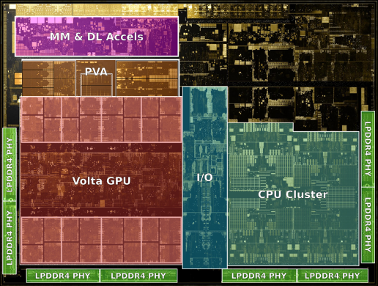
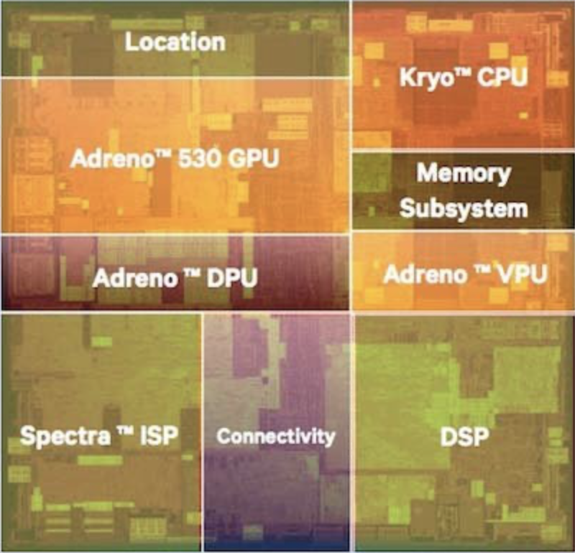
Programming Heterogeneous Systems is a Bigger Issue in Embedded/Mobile Computing
How to program these heterogeneous SoC?
Xavier SoC from Nvidia
Snapdragon SoC from Qualcomm

Slide 4
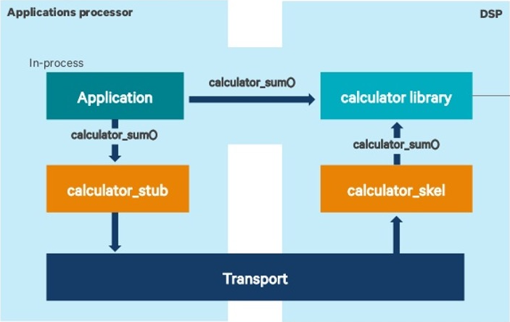
Qualcomm Snapdragon Architecture and Programming
Snapdragon Programming Models
ARM Kryo CPU: C/C++ with OpenMP
Adreno GPU: OpenCL, OpenGL, Vulkan, and DirectX
Hexagon DSP: C/C++ and Assembly language
Spectra ISP, MDSP, NPU: custom Qualcomm API
Quad Little Cores (cpu 0-3)
3 Big Cores (cpu 4-6)
Primary Core (cpu 7)
ARM A76
ARM A76
ARM A76
L1D
64 KB
L1I
64 KB
L1D
64 KB
L1I
64 KB
L1D
64 KB
L1I
64 KB
L2 (128 KB)
L2 (256 KB)
L2 (512KB)
300 MHz to 1.8 GHz
710 MHz to 2.4 GHz
825 MHz to 2.8 GHz
Hexagon DSP SDK
L3 (2 MB)
Qualcomm System Fabric
Adreno 640
Hexagon 690
LPDDR4X
Spectra 380
Camera
ISP
X24 +
X50
LTE+5G
Modem
(384) x 2 ALUs
1024b Vector Units
4 Channel
1 MB On-chip Memory
Tensor Accelerator
6 to 16 GB
250 to 600 MHz
576 MHz
2.1 GHz
Qualcomm Snapdragon Architecture
Notes:
Narasinga

Slide 5
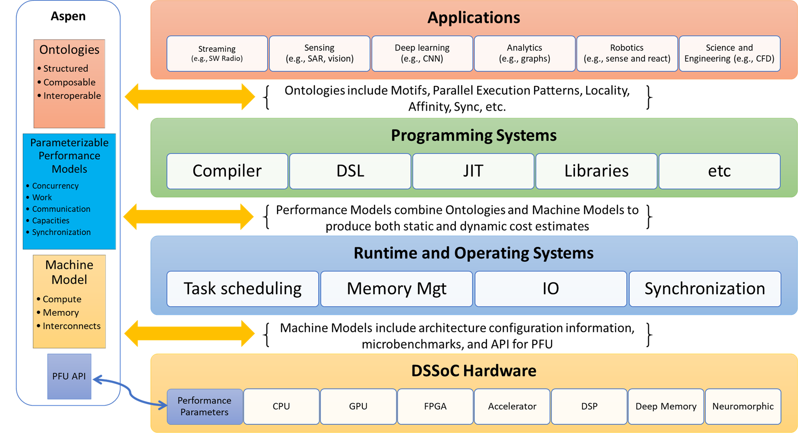
Cosmic Castle for Programming Heterogeneous SoCs
Main Programming System

Slide 6
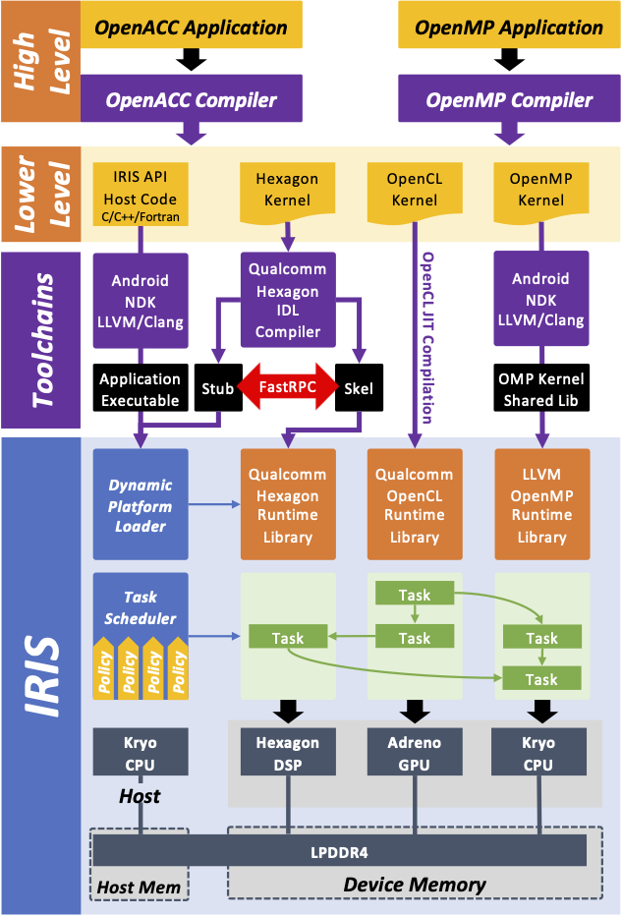
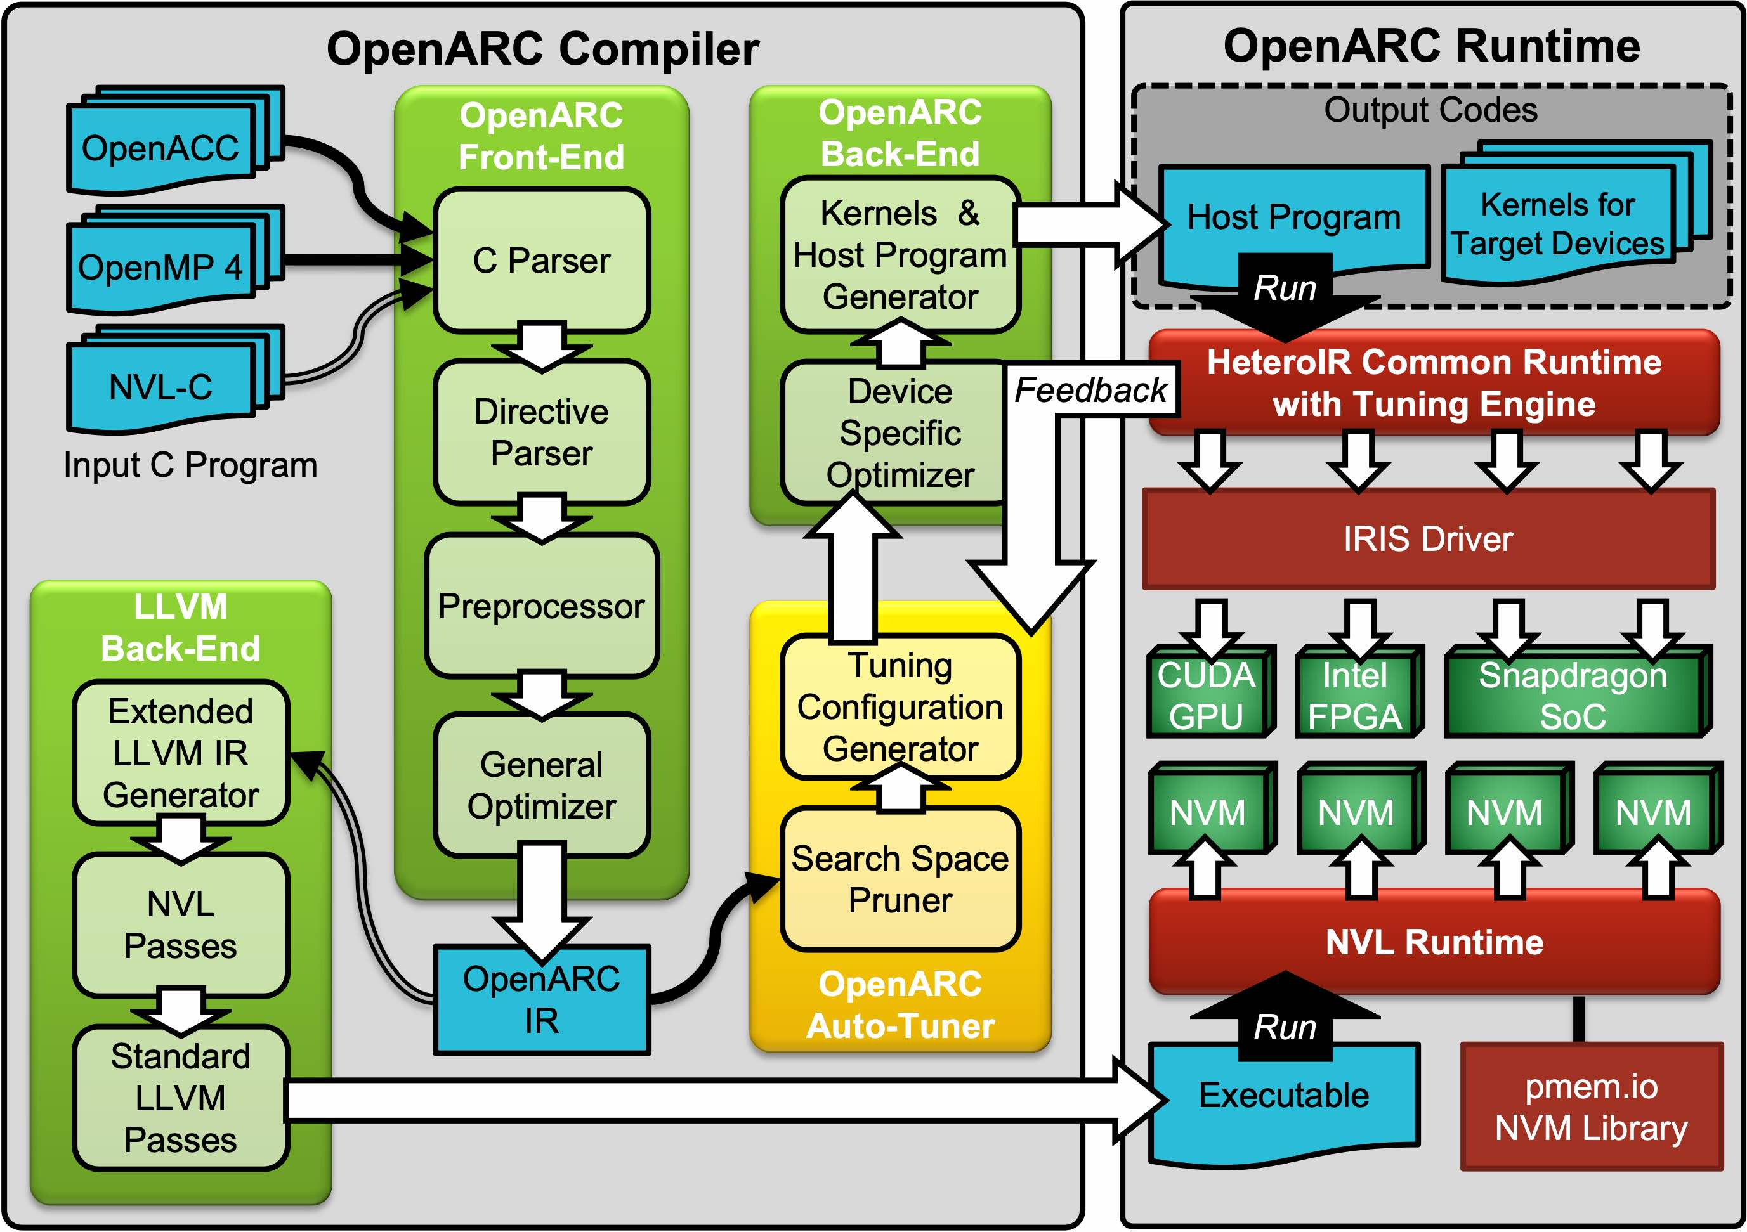
Cosmic Castle Main Programming System
OpenARC Compiler
Provide programmers a unified programming environment to write portable code across heterogeneous architectures (and preferred programming systems)
Orchestrate diverse programming systems (OpenCL, CUDA, HIP, OpenMP, Hexagon) in a single application
Refer to following papers for more details on IRIS and OpenARC:
J. Kim, S. Lee, B. Johnston, and J. S. Vetter, “IRIS: A portable runtime system exploiting multiple heterogeneous programming systems,” in IEEE High Performance Extreme Computing (HPEC), 2021.
S. Lee and J. S. Vetter, OpenARC: Extensible OpenACC Compiler Framework for Directive-Based Accelerator Programming Study, Workshop on Accelerator Programming Using Directives (WACCPD) in conjunction with SC14, 2014.
IRIS Runtime for Snapdragon SoC

Slide 7
SGEMM Performance on Snapdragon SoC

Slide 8
Performance Comparison of Heterogeneous Devices on Snapdragon SoC
SAXPY and Sobel Filter Benchmarking
Runtime-Split of Sobel Filter on Hexagon DSP

Slide 9
Summary
Cosmic Castle is a software ecosystem for performance portable programming on the heterogeneous SoCs.
Preliminary evaluation of Cosmic Castle on the Snapdragon SoC shows that Cosmic Castle allows users to program SoCs by using directive-based high-level programming models while exploiting and intermixing different device- specific programming models preferred by each heterogeneous device.
The initial performance comparison against manual low-level implementations shows the need for exploring further optimization opportunities.

Slide 10
Acknowledgments
This research used resources of the Experimental Computing Laboratory and the Oak Ridge Leadership Computing Facility at Oak Ridge National Laboratory, which are supported by the US Department of Energy's Office of Science of under contract no. DE-AC05-00OR22725.
This research was supported by (1) the Defense Advanced Research Projects Agency's Microsystems Technology Office, Domain-Specific System-on-Chip Program and (2) DOE Office of Science, Office of Advanced Scientific Computing Research, Scientific Discovery through Advanced Computing program.
This manuscript has been authored by UT-Battelle, LLC, under contract DE-AC05-00OR22725 with the US Department of Energy (DOE). The US government retains and the publisher, by accepting the article for publication, acknowledges that the US government retains a nonexclusive, paid-up, irrevocable, worldwide license to publish or reproduce the published form of this manuscript, or allow others to do so, for US government purposes. DOE will provide public access to these results of federally sponsored research in accordance with the DOE Public Access Plan (https://energy.gov/downloads/doe-public-access-plan).

